Slide 1
Text Mining and Information Retrieval using SVD in LSI (Latent Semantic Indexing)

Slide 2
Introduction
Latent semantic indexing (LSI) is an indexing and information retrieval method.
It is one of the major analysis approaches in the field of text mining.
It helps in finding out the documents which are most relative with the specified keyword.
It also helps the search engines to give most appropriate results for the search query.
..

Slide 3
Linear algebra Concepts Used.
Singular value decomposition(SVD)
Frobenius norm
Tf-idf Formula
Jacobi Method
Transpose
Inverse→ Orthogonal Matrices
Matrix Multiplication

Slide 4
Why We Use Singular value decomposition? (SVD)
Singular value decomposition (SVD) is used to find the optimal set of factors which predict the best outcome. It is used in LSA to find the documents related to searched keyword.
SVD is used to reduce the number of rows while preserving the similarity structure among columns.
SVD is used to identify patterns in the relationships between the terms and concepts contained in the form of an unstructured collection of text.

Slide 5
Errors
How we solved it
Wrong eigenValues and eigenVectors.
This was encountered because of some minor errors in implementation of jacobi and QR.
It was not implemented due to minor mistake of syntax.
Deletion of numeric data.
Incorrect dimensions of matrices
Because of some wrong interpretation of particular matrix.
None type error - It was failing to return anything.
We called and used the function find_k() for the search.But still it didn’t worked.
Reason :While loop for jacobi theorem was not working properly .
Dataset of SciKit-Learn was not getting loaded.

Slide 6
Errors
How we solved it
Code was going in infinite loop
It was not infinite loop but the code was taking huge amount of time as the dimensions of matrix were large.
Initially we were doing Half SVD because we thought that it will reduce our time complexity and this gave us incorrect results.
Then we get to know that this will not give the exact relations between the documents and concepts.
Then we applied some LA concepts like computing SVD of At,etc. and it was solved.
For Number of Rows> Number of Columns → We were getting wrong answers for SVD.
Precision of numbers were generating too much errors as some numbers which were 0 are given as 0.13149012e-15 etc. And same with the non-zero number
It was solved by rounding decimals from the numbers.

Slide 7
Unable to solve errors
Relevance Score sometimes comes out to be negative, for that we have converted that value into zero.
If there are same number of keywords in any two documents ,then we get any of those document as output as the best search because of the precision issues in Relevance Score values.
We were not able to make our code fast this gave us learning that how efficient and fast the inbuilt modules are.
We wanted to implement numba for making our code more efficient but we were not able to solve the ‘cannot import name 'jit' from partially initialized module 'numba' ‘

Slide 8
Coding and simulation part
Types of modules and libraries used.
Matplotlib: For plotting graphs
Numpy: For using various functions efficiently (Though they are done by us from scratch too.)
Pandas: For making dataFrames
NLTK: For removing Stopwords
Sklearn: For accessing various datasets

Slide 9
STEP-1: Loading and Preprocessing data in text format
We loaded the documents from SciKit learn fetch_20newsgroup dataset also we made our own datasets and removed all footers, quotes, punctuations and numbers from it.
Using nltk.tokenize.wordpunct_tokenize(), we tokenized the first ‘n_docs’ number of documents and stored them in all_docs.
We traverse through all docs and remove all words which are ‘stopwords’ by BOW(‘Bag of Words’.). Then we remove all the null values using filter().
Then we made a wordset (a set of unique words) of bow.

Slide 10
STEP-2: Creating TF-IDF matrix
We use a function called term_document_matrix() to find the number of times a particular word appears in each document. It returns a pandas DataFrame of worddict after carrying out the necessary operations.
We find frequency to the importance of a particular word in each and every document.

Slide 11
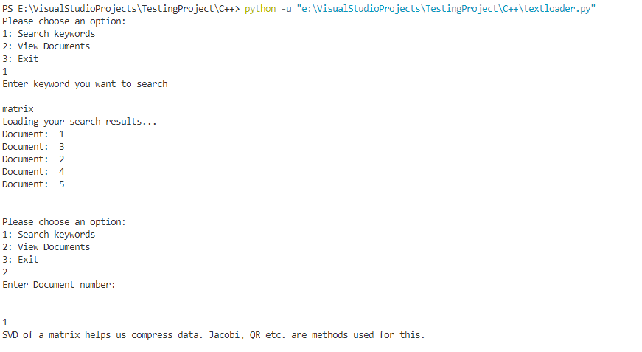
INPUT
We had taken and made datasets of file having some information(strings).
We had asked user to enter a string whose relevance order he wants to find.
We had asked users to write which document they want to see.

Slide 12
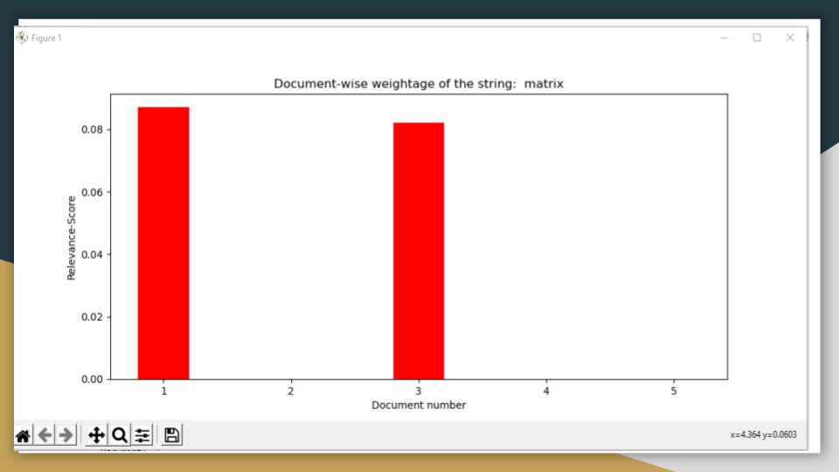
OUTPUT
Sequence of Documents in order with maximum similarity .
To show the document if user want to see.
Graph which shows the similarity of the searched keyword with the documents
Y→ Relevance Score
X→ Number of Documents

Slide 13
Approaches we implemented vs Approaches we tried to implement
Jacobi vs QR Decomposition & Power Iteration
For SVD: We used basic matrix multiplication, Transpose and Inverse vs Null Space,RREF,Solving System of Linear Equations.
Normal Matrix Multiplication Approach vs Dot of numpy
Transpose vs Numpy transpose
Our own documents vs scikit learn dataset documents .

Slide 14
THANK YOU

